Slide 1
Chapter 18
Mean Analysis

Slide 2
Learning Objectives
Explain the concept of means procedure
Discuss the statistics related to means procedure
Demonstrate the steps used in SPSS to execute means procedure
Explain how to analyse and interpret the means statistics

Slide 3
Discuss how to compute means by incorporating one and two additional variables
Explain the importance of one-way ANOVA statistics during application of means procedure and how to interpret the results
Discuss the concept and interpretation of Eta and Eta squared
Explain the advantages and disadvantages of Eta squared

Slide 4
Statistics Related to Means Procedure
Median: The median resembles the 50th percentile and indicate the value at above and below half of the cases appears.
Standard error of the mean: The standard deviation of mean statistic derived from the sampling distribution is known as standard error of mean.
Sum: The sum or total of values for all the cases.
Minimum: The smallest value of a variable based on metric data.
Maximum: The largest value of a variable based on metric data.

Slide 5
Range: The difference between the maximum and minimum value of a variable.
Variance: Variance indicates the measure of dispersion around the mean and equals to the sum of squared deviation from the mean divided by one less than number of cases for the respective sample.
Kurtosis: A measure to indicate how much data is far or closer to mean value. The shape of distribution will become more peak or flat in case of data close or away from the mean, respectively.

Slide 6
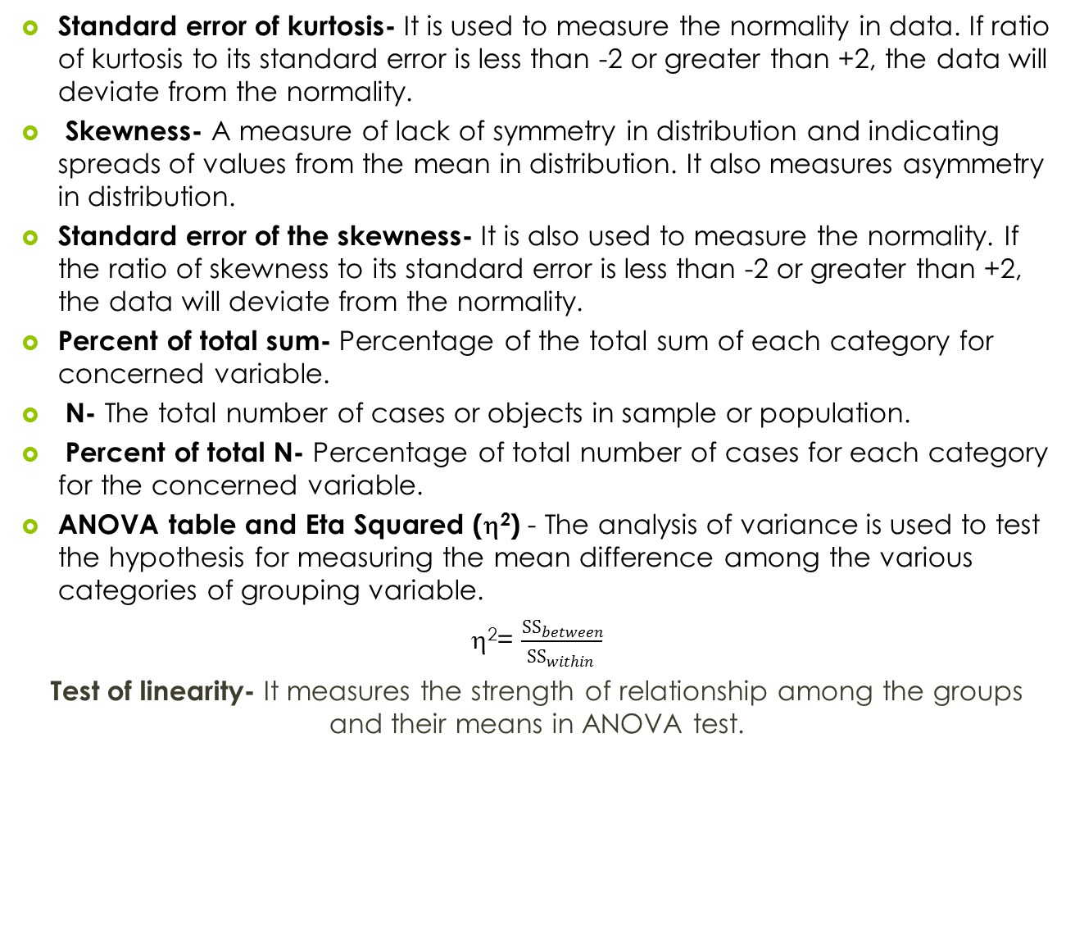

Slide 7
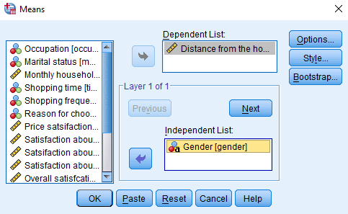
Executing Means Procedure by Using SPSS
Exhibit 18.1. Use retail.sav » Menu bar » analyse » Compare means » Means » Select Distance and transfer to Dependent List » Select Gender and transfer to Independent List » Click OK
Table 18.1. Means of distance
Gender | Distance | Gender | Distance
Male | 6.0 | Female | 5.5

Slide 8
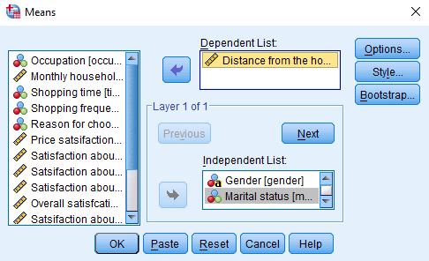
Means: Two Independent Variable Separately
The SPSS produces various tables simultaneously based on the number of variables entered in dependent and independent list during the execution process.
Exhibit 18.2. Use retail.sav » Menu bar » analyse » Compare means » Means » Select Distance and transfer to Dependent List » Select Gender and Marital and transfer to Independent List » Click OK

Slide 9
Table 18.2a. Means of Distance for Gender
Gender | Distance Covered (Km)
Male | 6.0
Female | 5.5
Total | 5.8
Table 18.2b. Means of Distance for Marital
Marital Status | Distance Covered (Km)
Married | 6.1
Single | 5.2
Total | 5.8

Slide 10
Computing Means with One Additional Layering Variable
Due to addition of one layering variable along with the independent variable, the parent table will be subdivided into certain panels as per the levels of controlling variable.
Exhibit 18.3. Use retail.sav » Menu bar » analyse » Compare means » Means » Select Price and transfer to Dependent List » Select Gender and transfer to Independent List » Click Next » Select frequency and transfer to Independent List » Click OK

Slide 11
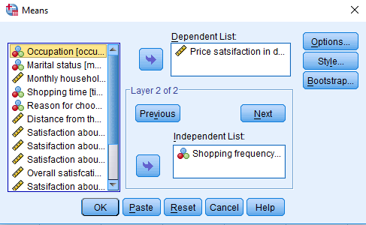

Slide 12
One Additional Layering Variable
Table 18.3. Mean Rating with One Additional Layering Variable
Category-1 | Shopping Frequency | Mean | Std. Deviation | Category-1 | Mean | Std. Deviation
Male (Price satisfaction = 5.3) | First time | 6.1 | 2.3 | Female (Price satisfaction = 6.1) | 4.0 | 0.81
 | Once per month | 4.5 | 2.7 |  | 6.1 | 2.3
 | Once per week | 5.0 | 2.6 |  | 6.6 | 1.9
 | More than once in week | 5.1 | 2.9 |  | 6.3 | 3.3
 | Not fixed | 6.1 | 1.9 |  | 6.0 | 0.81
 | Total | 5.3 | 2.6 |  | 6.1 | 2.4

Slide 13
Descriptive Statistics with Mean Procedure
Descriptive statistics such as median, standard error of mean, sum, number of cases in mean, minimum, maximum, range, standard deviation, variance, kurtosis, skewness, standard error of kurtosis and skewness, and percentage of total sum are computed by SPSS to gain better understanding of data summary.
Exhibit 18.4. Use retail.sav » Menu bar » analyse » Compare means » Means » Select Price and transfer to Dependent List » Select Income and transfer to Independent List » Click Options and transfer Desired descriptive statistics into Cell Statistics » Continue » Click OK

Slide 14
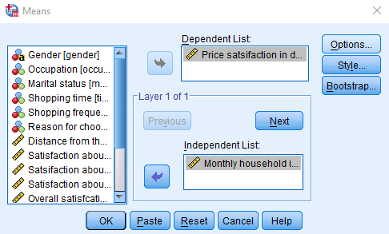
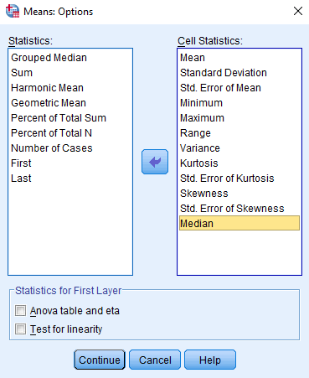

Slide 15
Descriptive Statistics
Table 18.4. Descriptive Statistics with Mean Procedure
Descriptors | Monthly Household Income Categories (₹)
 | <10000 | 10001–20000 | 20001–30000 | 30001–40000 | >40000 | Total
Mean | 5.6 | 6.1 | 5.4 | 5.7 | 5.4 | 5.6
Std. deviation | 2.4 | 2.2 | 2.4 | 3.2 | 2.04 | 2.5
Std. error of mean | 0.47 | 0.54 | 0.51 | 0.58 | 0.43 | 0.23
Minimum | 1.00 | 4.00 | 1.00 | 1.00 | 1.00 | 1.00
Maximum | 10.00 | 10.00 | 10.00 | 10.00 | 9.00 | 10.00
Range | 9.00 | 6.00 | 9.00 | 9.00 | 8.00 | 9.00
Variance | 6.08 | 5.11 | 6.07 | 10.46 | 4.16 | 6.56
Kurtosis | −0.586 | −1.108 | −0.810 | −1.333 | 0.438 | −0.737
Std. error of kurtosis | 0.872 | 1.063 | 0.935 | 0.821 | 0.953 | 0.438
Skewness | −0.102 | 0.681 | −0.034 | −0.068 | −0.723 | −0.042
Std. error of skewness | 0.448 | 0.550 | 0.481 | 0.421 | 0.491 | 0.221
Median | 5.0 | 5.0 | 6.0 | 6.0 | 6.0 | 6.0

Slide 16
Analysis of Variance (ANOVA) and Eta
The means procedure also examines the Analysis of Variance (ANOVA) and Eta for independent variable in the first layer scenario. One-way ANOVA is used to measure whether the mean difference is significant across the categories.
Other measures like Eta and Eta squared are the most common reported estimates of effect size in case of ANOVA results.
Exhibit 18.5. Use retail.sav » Menu bar » analyse » Compare means » Means » Select Parking and transfer to Dependent List » Select Occupation and transfer to Independent List » Click Option » Click OK

Slide 17
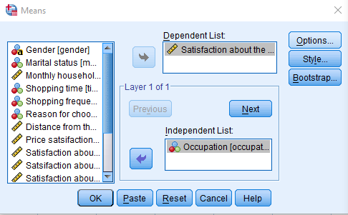
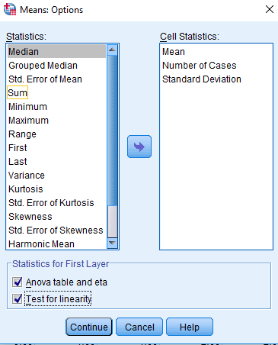

Slide 18
Descriptors of Sample
Table 18.5a. Means: Satisfaction for Parking
Occupation | N | Mean | Std. Deviation | Occupation | N | Mean | Std. Deviation
Business | 36 | 1.4 | 0.69 | Students | 16 | 2.0 | 1.2
Government employee | 22 | 1.5 | 0.74 | Housewife | 15 | 4.1 | 0.63
Private employee | 31 | 3.2 | 1.34 | Total | 120 | 2.3 | 1.39

Slide 19
ANOVA Statistics
 |  | Sum of Squares | Df | Mean Square | F | Sig.
Parking * Occupation | Between groups (Combined) | 120.6 | 4 | 30.1 | 31.50 | 0.000
 | Within groups | 110.0 | 115 | 0.957
 | Total | 230.6 | 119
The lower p-value from 0.05 (p < 0.05, 0.000) at 5 per cent LoS indicates that a significant difference exists among the mean scores for categories of occupation.

Slide 20
Measures of Association
Table 18.5b. Measures of Association
 | Eta | Eta Squared
Parking * Occupation | 0.723 | 0.523

Slide 21
Key Terms
Chi-Square statistics Contingency analysis Contingency Coefficient (C) Controlling variable Cramer’V Cross tabulation Data visualization Expected frequency Goodman and Kruskal tau (τ) | Interaction effect Lambda Marginals Measures of association Moderating variable Observed frequency Phi Coefficient Uncertainty Coefficient

